Slide 1

Breakfastclub
Master Thesis
How Personality Traits effect attention and happiness in a simulated classroom
manuel.pasieka@protonmail.ch

Slide 2
How different personalities effect classroom attention and happiness?

Slide 3

Master Thesis - Objectives
Master Thesis - Objectives
Develop a deterministic closed loop classroom simulation.
Base agent behavior on establish personality trait model.
Compare how different personality profiles effect individual agent and group behavior.

Slide 4
Content
What is an Agent based model?
How to derive agent behavior from a personality trait model?
The Simulation
Experiment & Results

Slide 5
Agent based models
An agent-based model (ABM) is a class of computational models for
simulating the actions and interactions of autonomous agents (both
individual or collective entities such as organizations or groups) with
a view to assessing their effects on the system as a whole.
- Wikipedia
Applied in various fields
Biology (e.g. epidemics)
Economics (e.g. Stock Trade)
Social Studies (e.g. Social Networks)

Slide 6
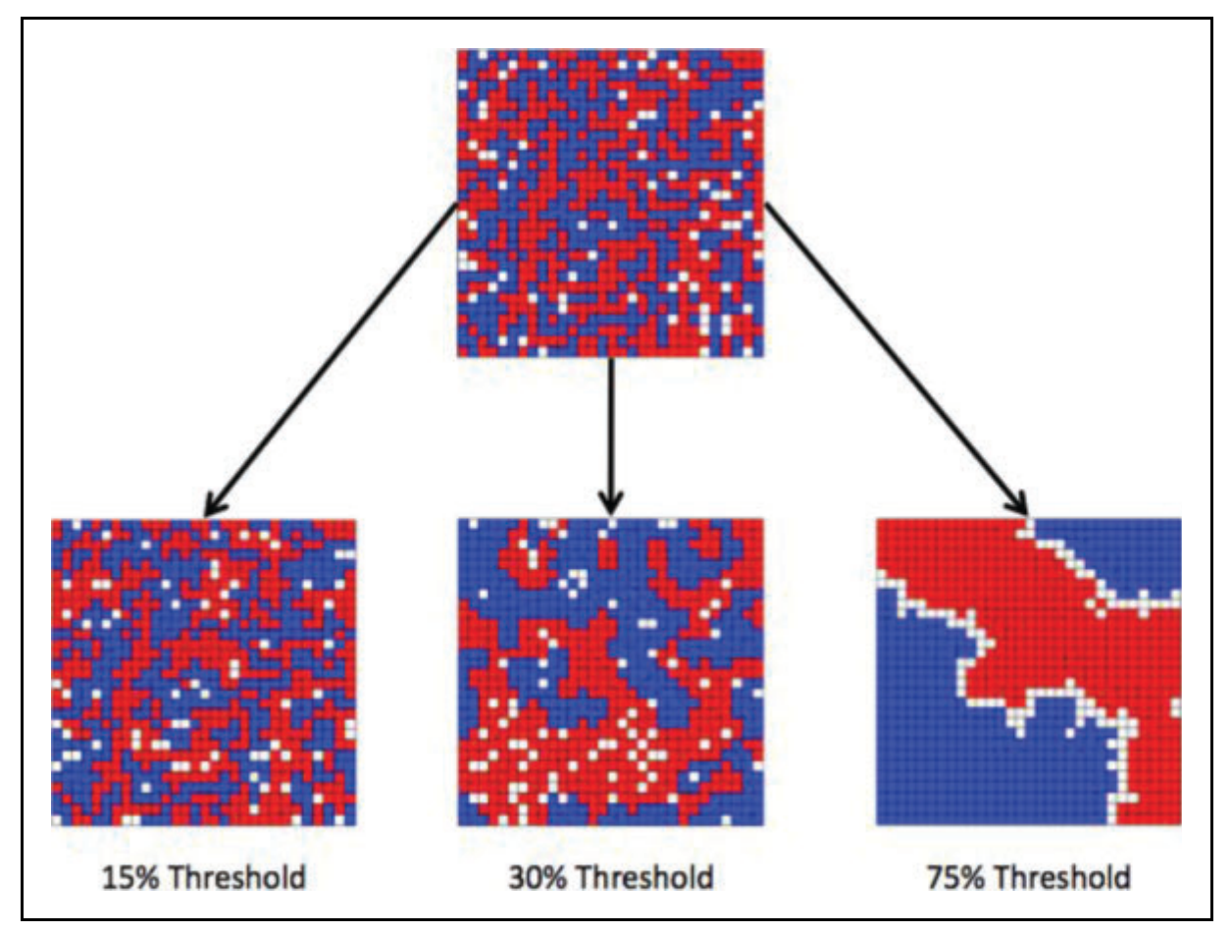
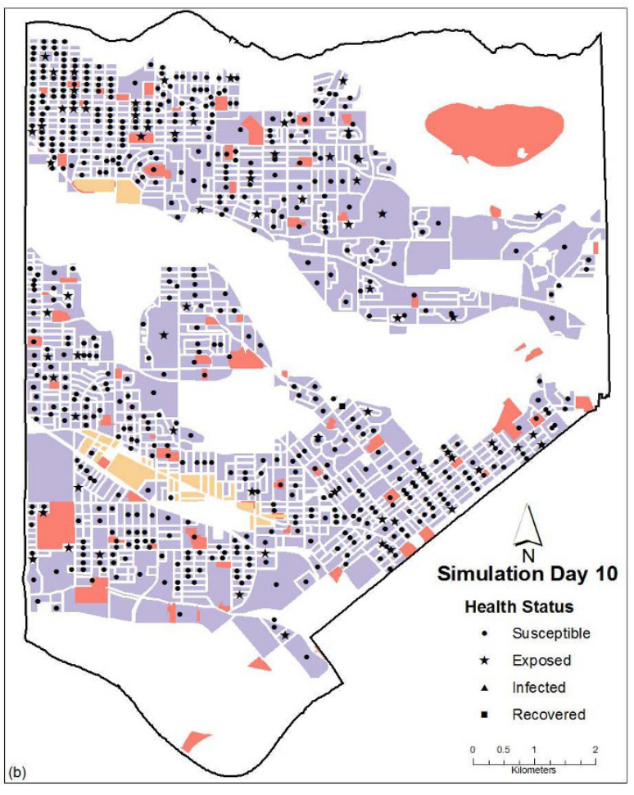
Agent based models - Examples
﻿Thomas Schelling’s (1971) – Social Segregation [1]
Perez (2009) – Contagious disease spread [2]
[1] Schelling, T. C. (1971). Dynamics Model of Segregation. Journal of Mathematical Sociology, 1(May 1969), 143–186.
[2] Perez, L., & Dragicevic, S. (2009). An agent-based approach for modeling dynamics of contagious disease spread.
International Journal of Health Geographics, 8(1), 1–17. https://doi.org/10.1186/1476-072X-8-50

Slide 7
How to derive agent behavior from a personality trait model?

Slide 8
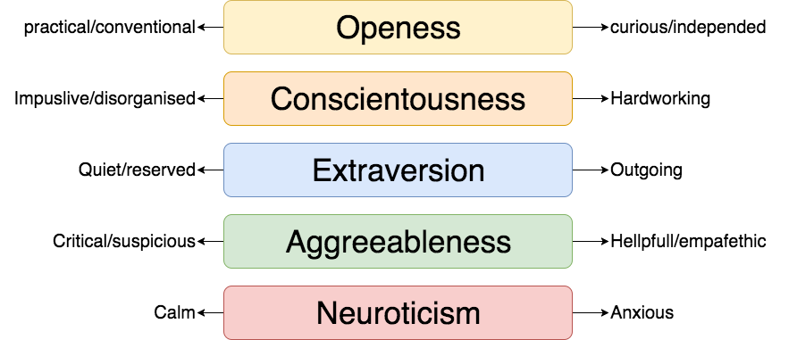
Big Five – Personality Trait Model
OCEAN or Big Five is a widely used empirical model, applied in theoretical and practical settings[1].
[1] Norman, W. T. (1963). Toward an adequate taxonomy of personality attributes. Journal of Abnormal and Social Psychology, 66(6), 574–583. https://doi.org/10.1037/h0040291

Slide 9
Big Five in the classroom
Empirical studies show how the big five effect the behavior or children in the classroom [1]
On school achievements and outcome [2]
Big Five in children with ADHD [3]
[1] Ehrler, D. J., Evans, J. G., & McGhee, R. L. (1999). Extending Big-Five theory into childhood: A preliminary investigation into the relationship between Big-Five personality traits and behavior problems in children. Psychology in the Schools
[2] Asendorpf, J. B., & Van Aken, M. A. G. (2003). Validity of Big Five Personality Judgments in Childhood: A 9 Year Longitudinal Study. European Journal of Personality, 17(1), 1–17. https://doi.org/10.1002/per.460
[3] Nigg, J. T., Blaskey, L. G., Huang-Pollock, C. L., Hinshaw, S. P., John, O. P., Willcutt, E. G., & Pennington, B. (2002). Big five dimensions and ADHD symptoms: Links between personality traits and clinical symptoms. Journal of Personality and Social Psychology, 83(2), 451–469. https://doi.org/10.1037/0022-3514.83.2.451

Slide 10
How to build a agent based model of a virtual classroom based on the Big Five?

Slide 11
Agent based models
Main Components
Environment (i.e. define the classroom)
Agents (i.e. possible behavior and characteristics)
Logic (i.e. how to select and control behavior)

Slide 12
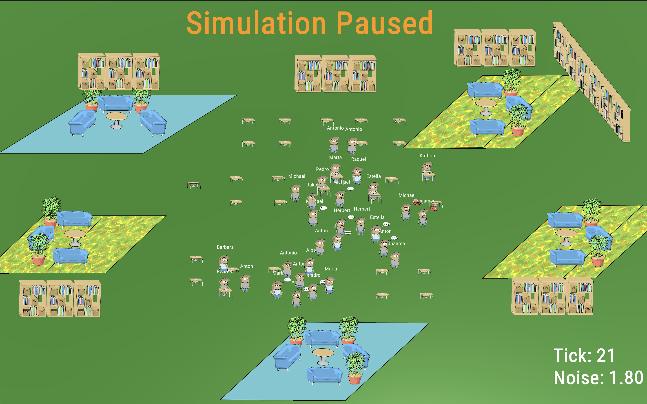
Environment
Number of Students
Individual/Group tables

Slide 13
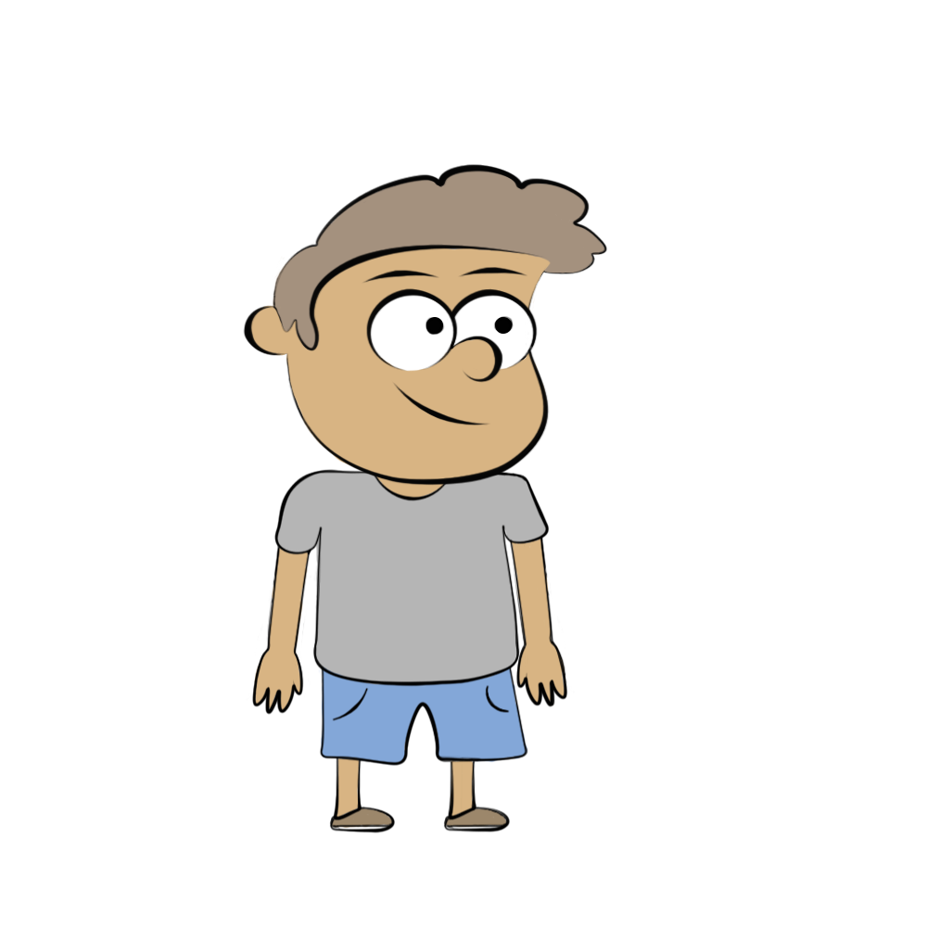
The Agents
Personality
Internal States
Behavior
Openness
Conscientiousness
Extraversion
Agreeableness
Neuroticism
Motivation
Happiness
Attention
Chat
Take a break
Study alone
Study in groups
Quarrel

Slide 14


Logic
Internal States
Action Scores
Peer Vector
Motivation
Happiness
0.01
0.33
0.15
0.89
0.44
Chat
Take a break
Study alone
Study in groups
Quarrel
Personality
Behavior
Openness
Conscientiousness
Extraversion
Agreeableness
Neuroticism
Interactions &Environment
Other agents
Available Tables
Noise Level

Slide 15
Influences on Agent Behavior
Internal States
Environment
Peer Pressure
Interactions
Notes:
Dynamic

Slide 16
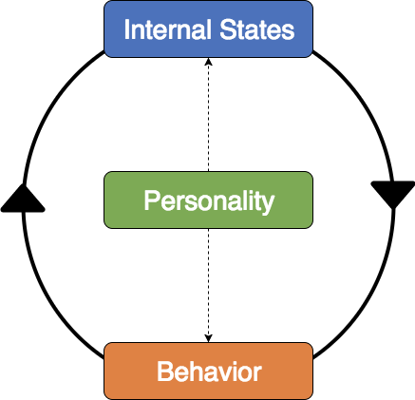
Agent Dynamics
Each Agent is a dynamic system
Parameterized by its Personality Traits
Internal States define and are altered by Agents Behavior
Notes:
Dynamic

Slide 17
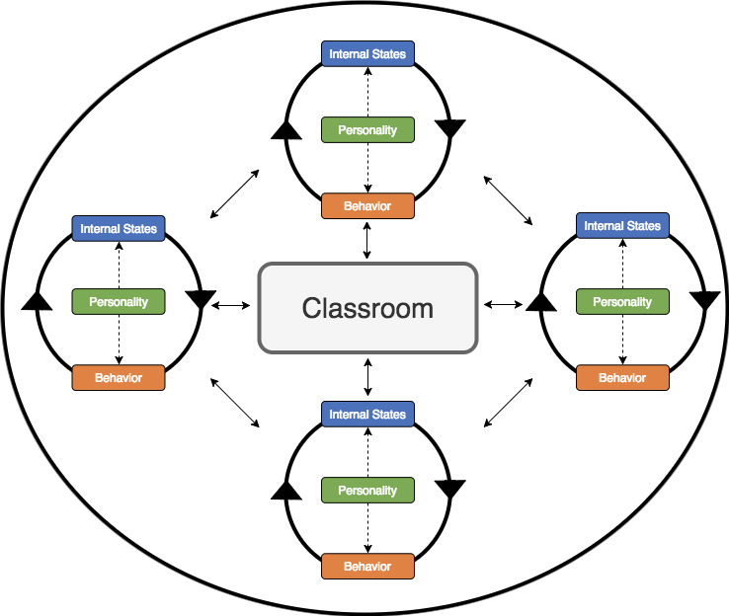
Group Dynamics
Agents interact with each other and the environment
Group dynamics emerge from agent interactions
Different Agent Profiles have different Group dynamics
Notes:
Dynamic

Slide 18
The Simulation

Slide 19
Simulation - Breakfastclub
Agent based model implemented in Unity3D
Agent behavior is based on OCEAN (Big Five) Personality Trait model
Models attention, happiness and motivation
Notes:
selbst lernende gruppe

Slide 20
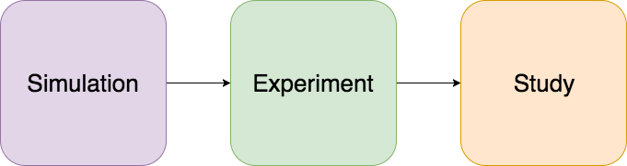
Three phase Analysis
What is the behavior of one set of agents?
What is the average happiness and attention of a combination of personalities?
How do different personality combinations compare to each other?

Slide 21
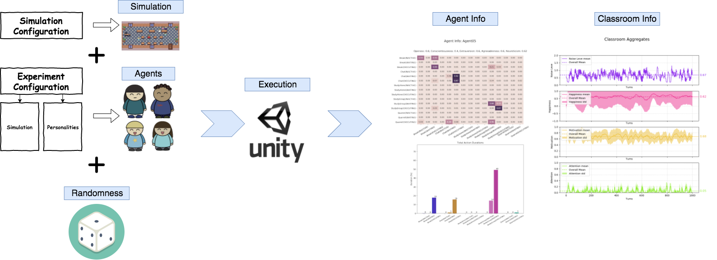
Simulation
What is the behavior of one set of agents?

Slide 22
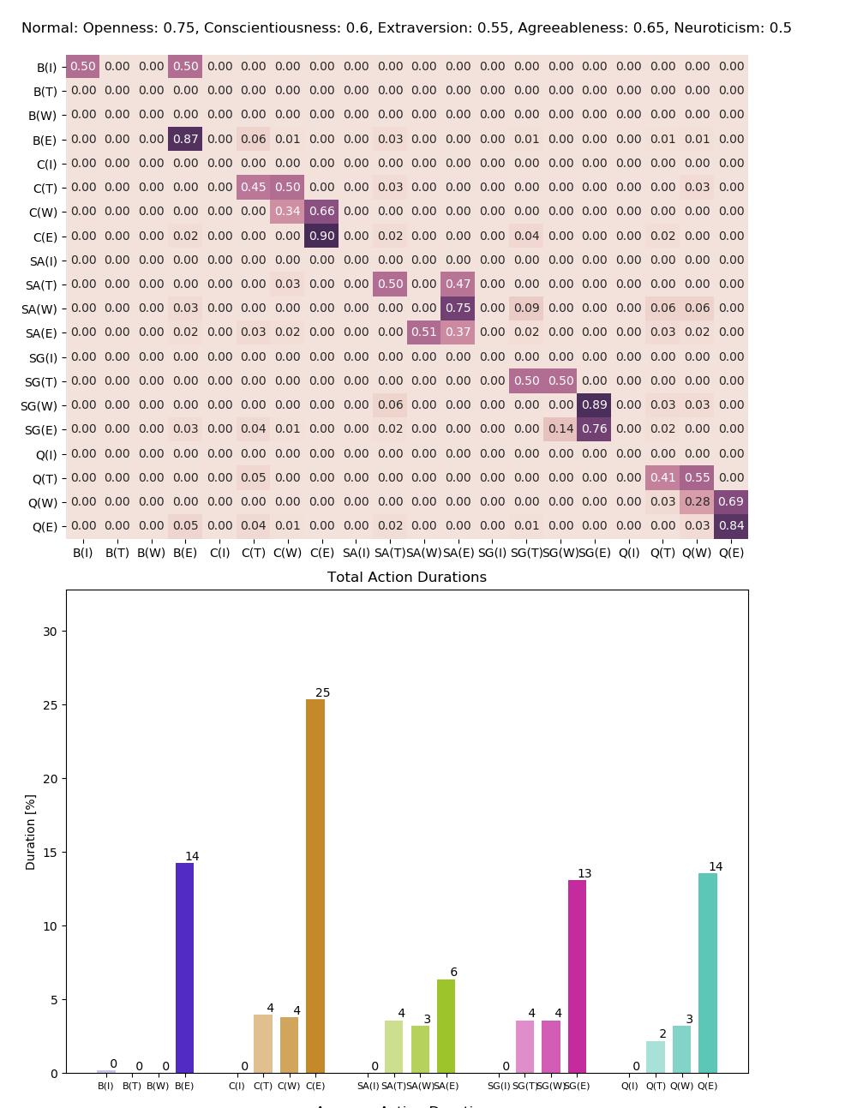
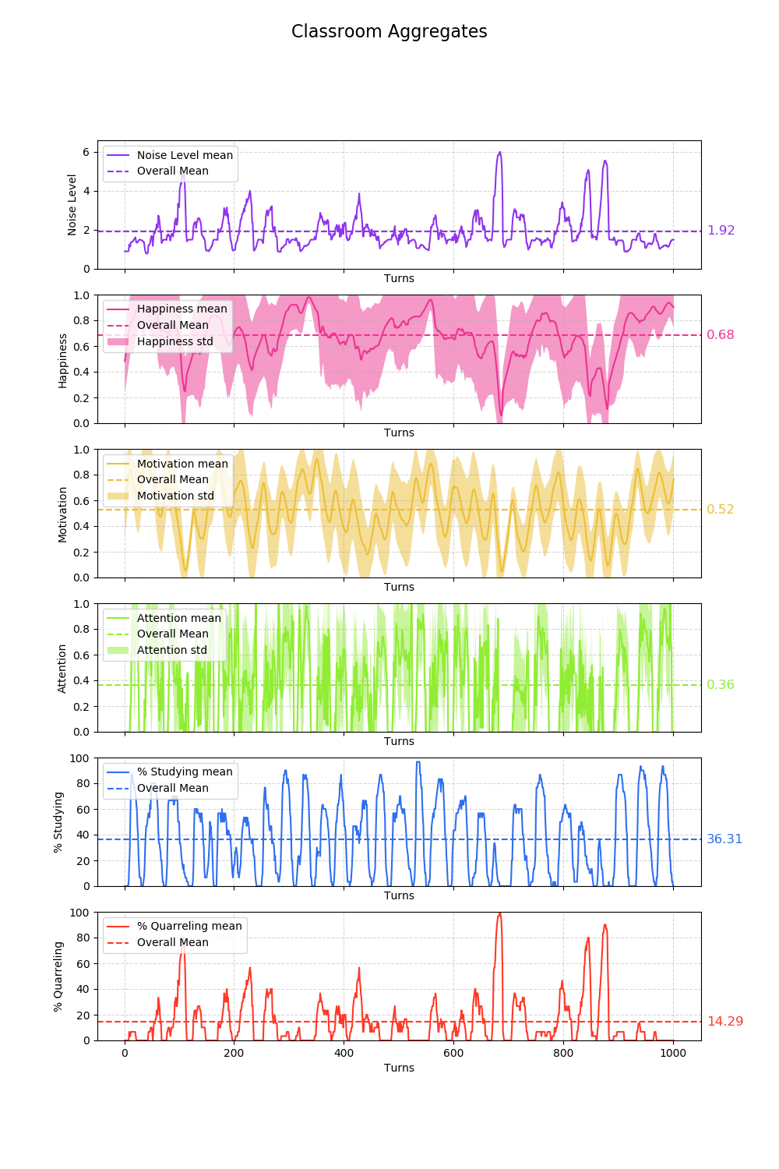
Agent Info
Classroom Info

Slide 23
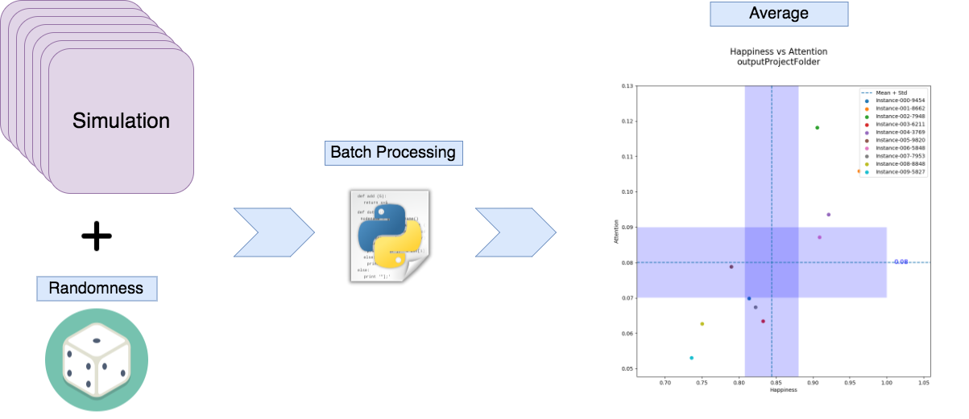
Experiment
What is the average happiness and attention of a combination of personalities?

Slide 24
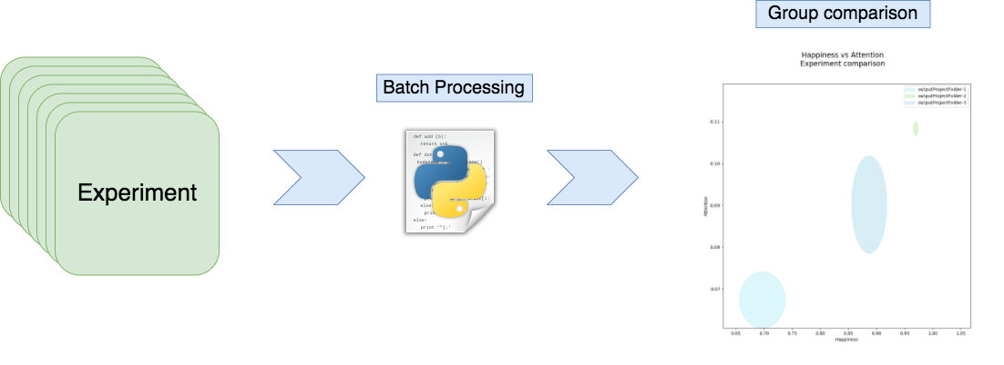
Study
How do different personality combinations compare to each other?

Slide 25
How different personalities effect classroom attention and happiness?

Slide 26
Experiment
Define different Student Types (Personality Trait Profiles)
Define Classrooms with different Student Type Distributions
Run multiple simulations per Classroom
Compare Classrooms

Slide 27
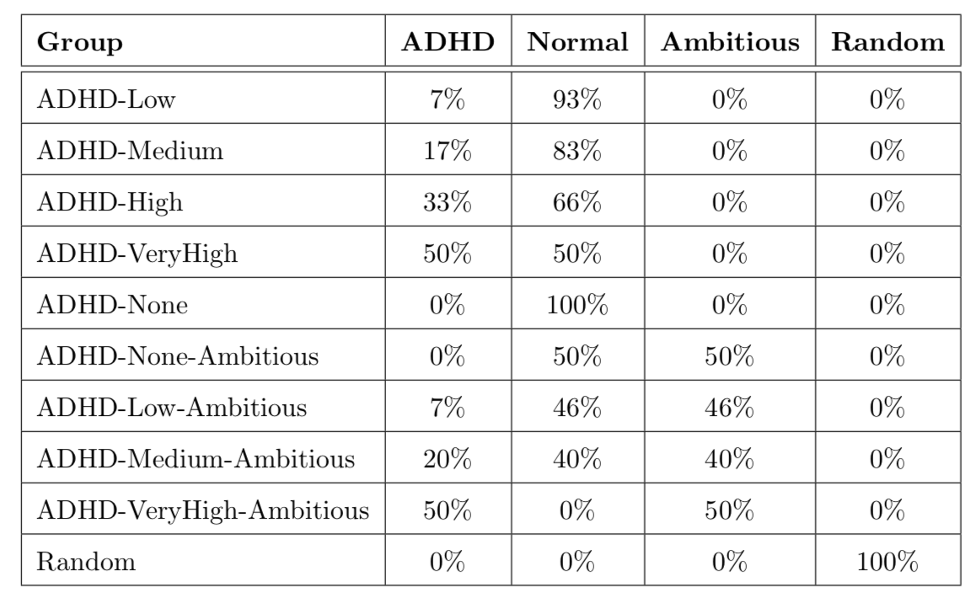
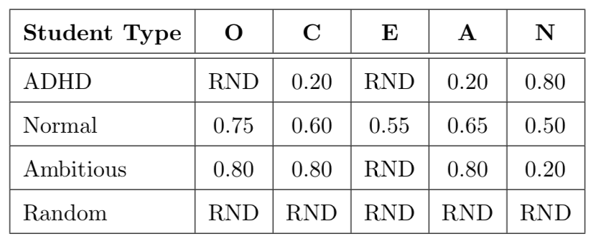
Agents and Classrooms
Personality Trait Profiles
Classroom Profiles
[1]
[1] Nigg, J. T., Blaskey, L. G., Huang-Pollock, C. L., Hinshaw, S. P., John, O. P., Willcutt, E. G., & Pennington, B. (2002). Big five dimensions and ADHD symptoms: Links between personality traits and clinical symptoms. Journal of Personality and Social Psychology, 83(2), 451–469. https://doi.org/10.1037/0022-3514.83.2.451

Slide 28
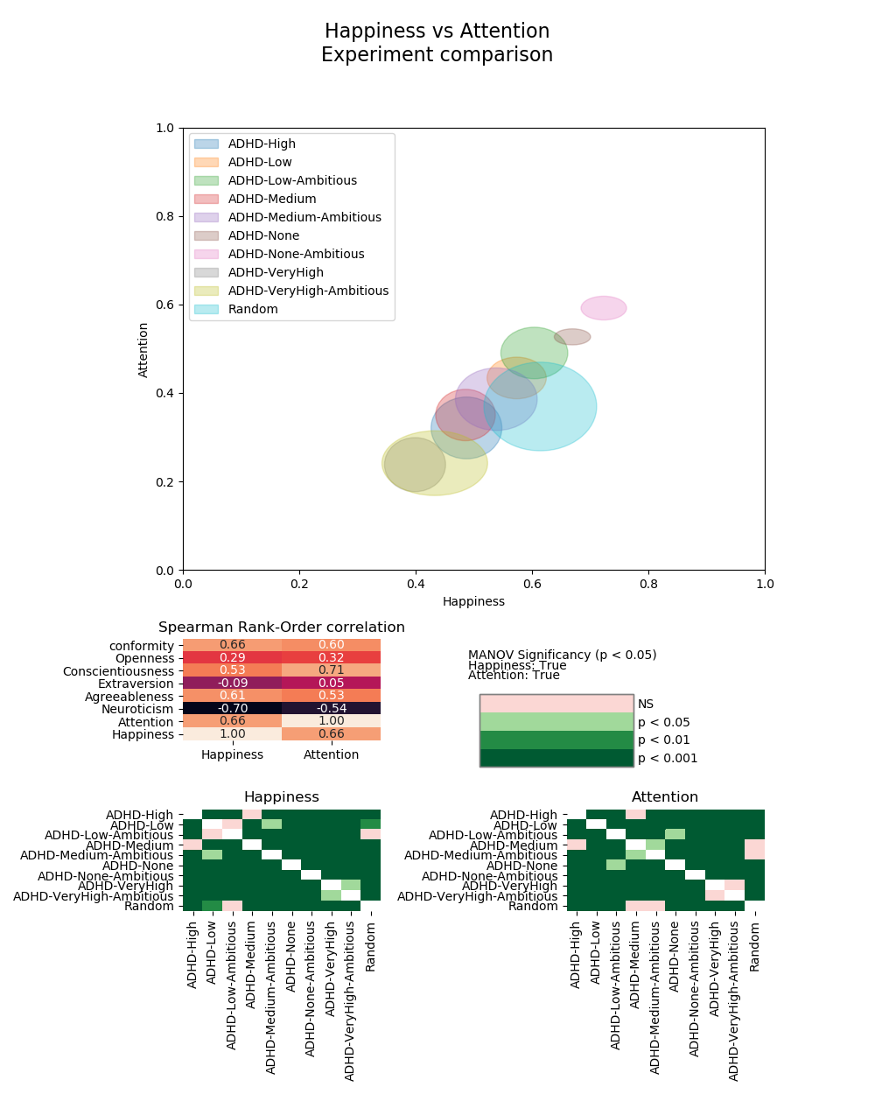
Results
ADHD-None-Ambitious
ADHD-None
Random
ADHD-VeryHigh-Ambitious
ADHD-VeryHigh

Slide 29
Result interpretation
ADHD and ambitious students, move average group happiness and attention in opposite directions
ADHD students have a far strong effect on the group than ambitious students

Slide 30
Conclusion
Breakfastclub implements an agent based model of a virtual classroom
Agent and group behavior is strongly effected by Personality Profiles
Simulating different classrooms profiles produce consistent behavior

Slide 31
Máster Universitario en Inteligencia Artificial
Pädagogische Hochschule St.Gallen
Prof. Dr. Michael Kickmeier-Rust
(Supervisor)
Thank you
Prof. Elena Verdu Perez
(Supervisor)
Felix Meissl
(Art Work)

Slide 33
Outlook
Improve classroom aggregates analysis
Interactive Simulation
Include a Teacher Agent

Slide 34
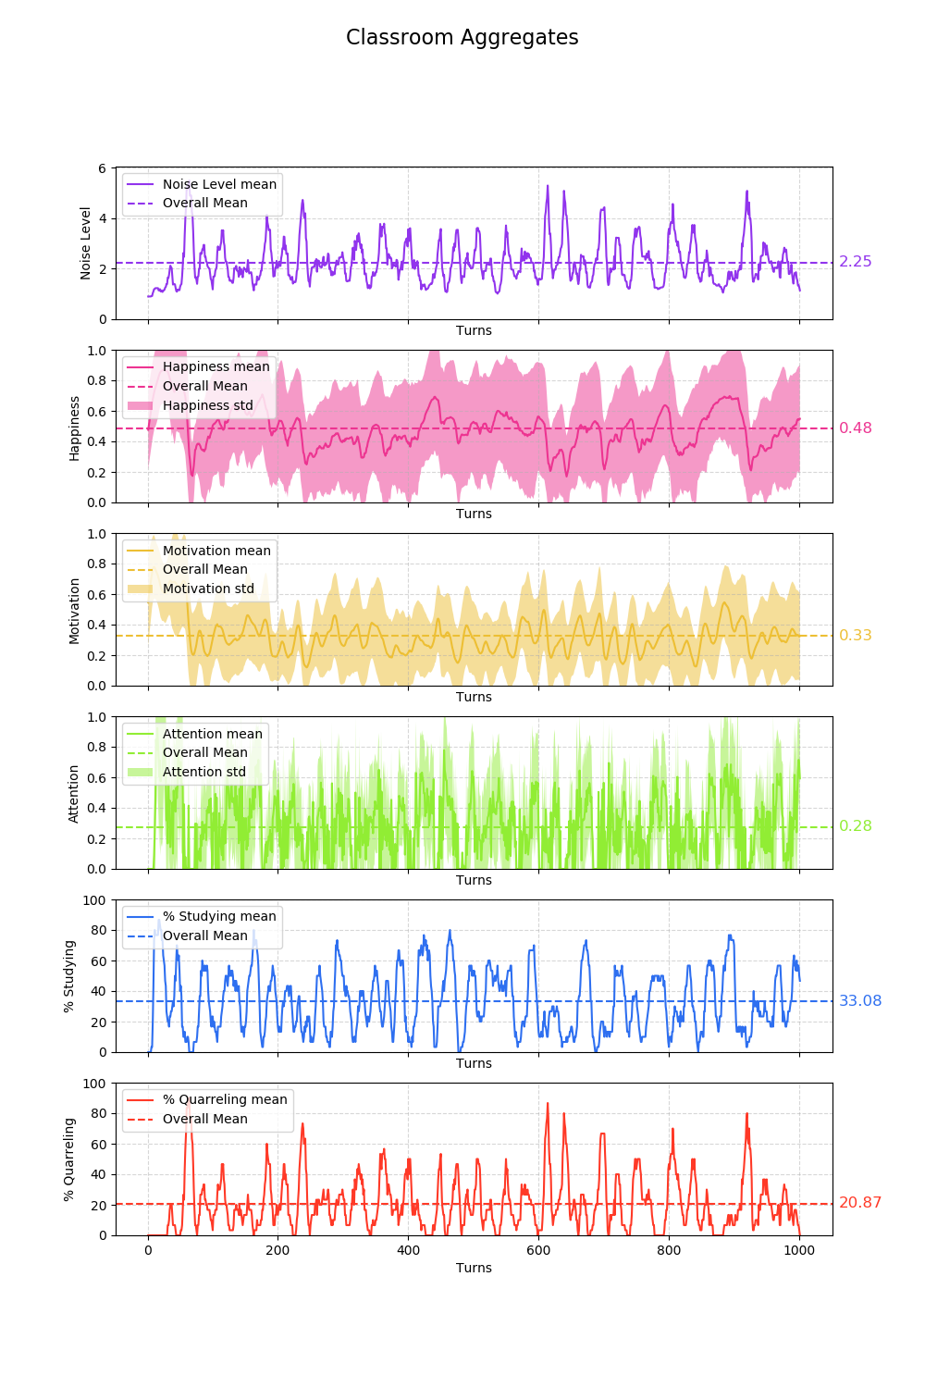
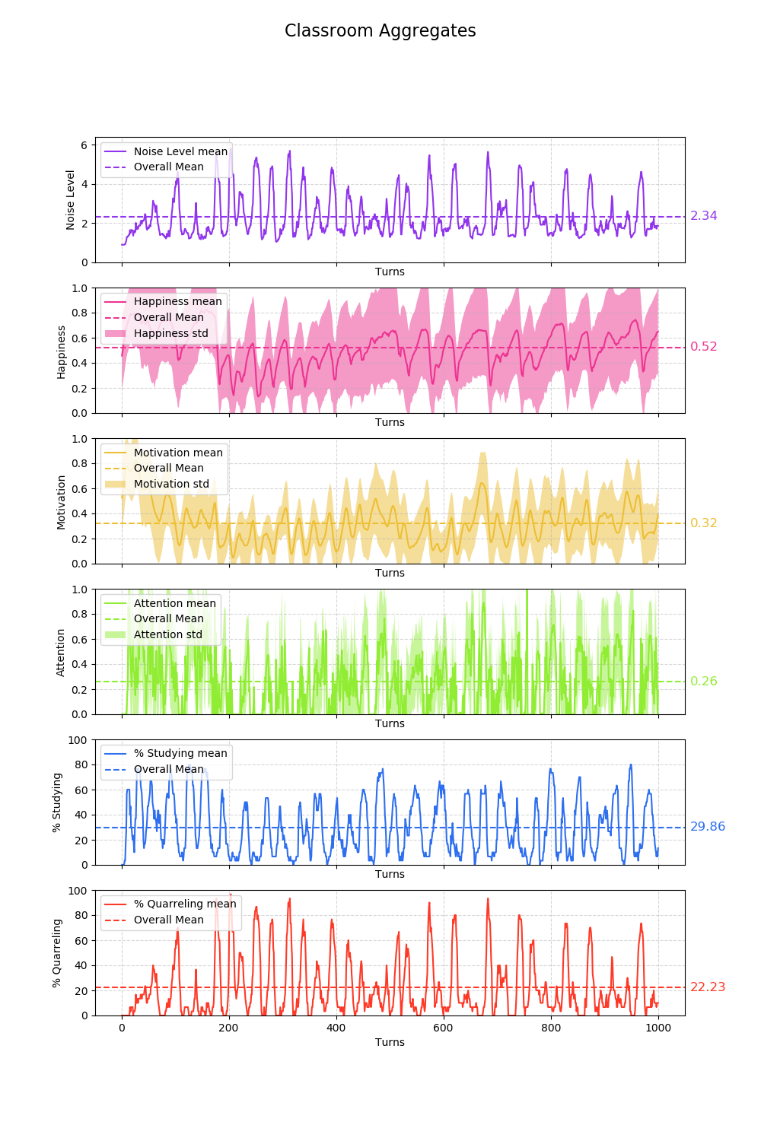
ADHD-None
ADHD-Medium
ADHD-Medium-Ambitious

Slide 35
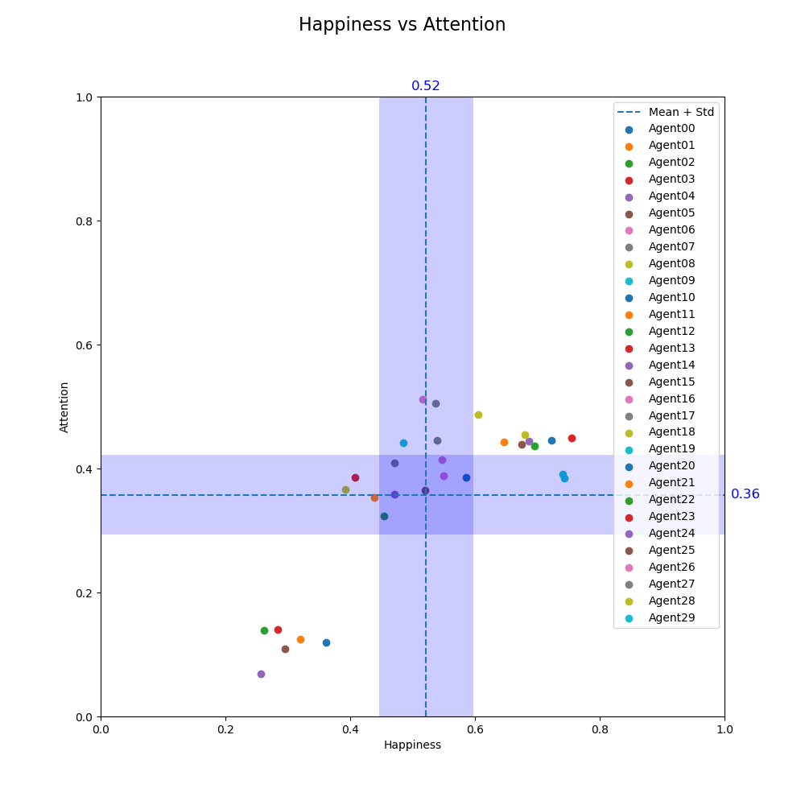
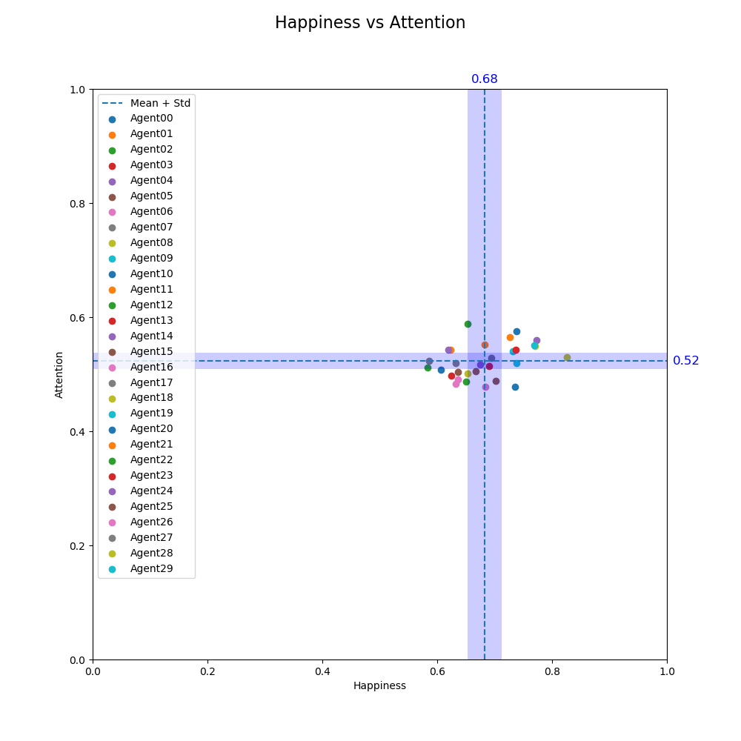
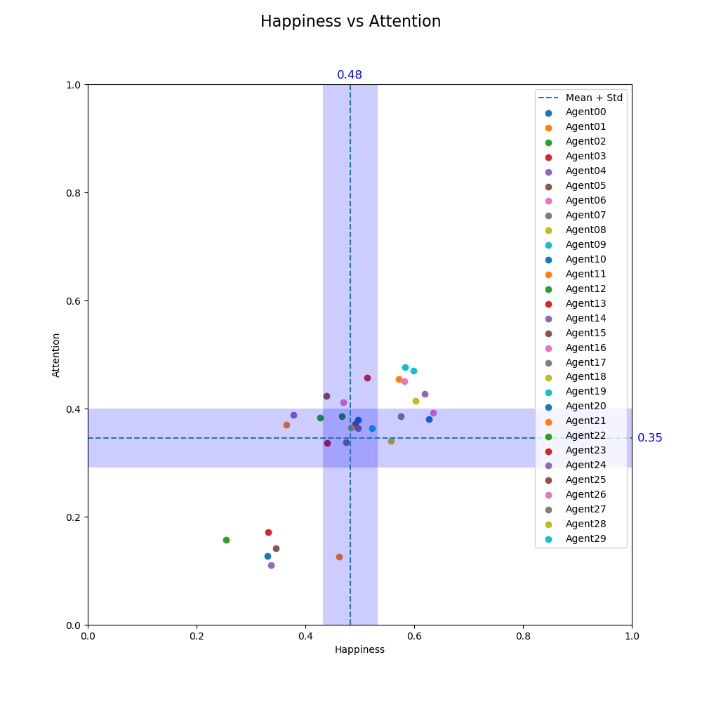
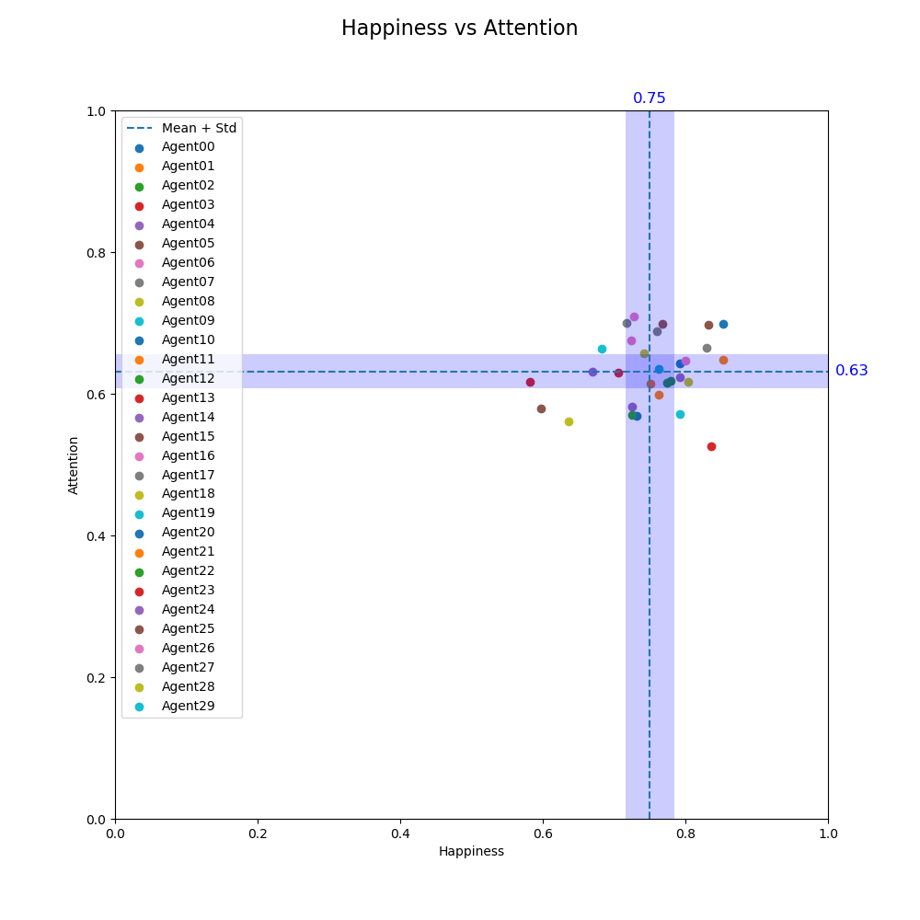
ADHD-Medium-Ambitious
ADHD-None
ADHD-Medium
ADHD-None-Ambitious

Slide 37
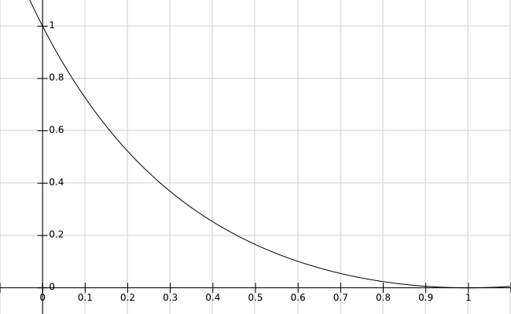
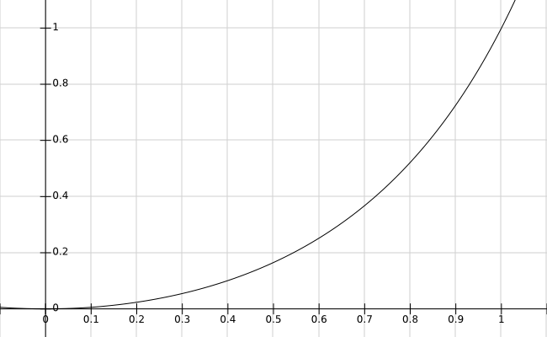
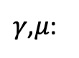
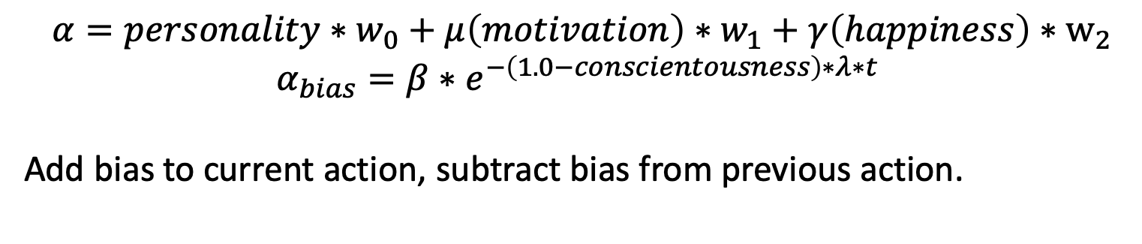
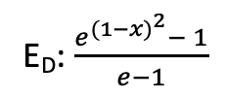
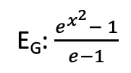
Action Scores
$$α=personality∗w_{0}+μ\left(motivation\right)∗w_{1}+γ\left(happiness\right)∗w_{2}$$
$$α_{bias}=β∗e^{−\left(1.0−conscientousness\right)∗λ∗t}$$
Add bias to current action, subtract bias from previous action.
E_{D}: $\frac{e^{{(1−x)}^{2}}− 1}{e−1}$
E_{G}: $\frac{e^{x^{2}}− 1}{e−1}$
$γ$,$μ$:
Break: 1.0 - extraversion, E_{D}, E_{G}
Chat: extraversion, E_{D}, E_{G}
Study Alone: 1.0 - extraversion, E_{G}, E_{G}
Study Group: extraversion, E_{G}, E_{G}
Quarrel: agreeableness, E_{G}, E_{D}

